Slide 1
Big Data Analytics 2023 Module 6 Big Data Applications
6.1 Link Analysis

Slide 2
Overview
Link Analysis : Early Search Engines, Spam
PageRank, Definition
Structure of the web-dead ends, Spider traps
Using Page rank in a search engine
Efficient computation of Page Rank using matrices.
MapReduce and PageRank
Link Spam and spam Farm
HITS Algorithm.

Slide 3
Applications : Graph Data!
High dim. data
Locality sensitive hashing
Clustering
Graph data
PageRank, SimRank
Community Detection
Infinite data
Filtering data streams
Web advertising
Dimensionality reduction
Spam Detection
Queries on streams
Machine learning
SVM
Decision Trees
Perceptron, kNN
Apps
Recommender systems
Association Rules
Duplicate document detection

Slide 4

the Internet!
Notes:
http://en.wikipedia.org/wiki/Internet

Slide 5
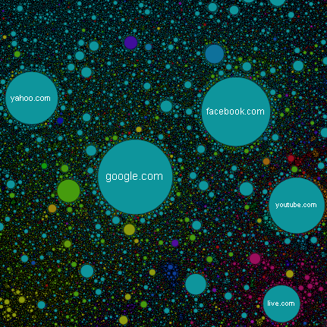

Slide 6
Google
Feb 2023 – Around 35 trillion webpages

Slide 7
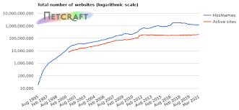
Exponential increase of websites
It is estimates that if “every 24 hours we get 547,200 increase in the total number of websites worldwide,” there are “over 380 websites are created every minute”.
Google accounts for an estimated 2.5 trillion searches per year.
The popular search engine dominates online search, ranked first for the most visited multi-platform websites

Slide 8
Search Engines
Search engines are answer machines.
They scour billions of pieces of content and evaluate thousands of factors to determine which content is most likely to answer your query.
Search engines do all of this by discovering and cataloguing all available content on the Internet (web pages, PDFs, images, videos, etc.) via a process known as “crawling and indexing,”
They then order the content by how well it matches the query in a process we refer to as “ranking.”

Slide 9
Internet surfing is a challenge
Data
User
Web Users and Content Creators come from diverse backgrounds have different motivations for using the web
Inexperienced user
Page manipulator
Large
Heterogeneous
absolute lack of coordination
“Web Search Engines” have disrupted the way the users have engaged with the Web.
Full-text index search engines such as Altavista, Lycos
Taxonomies based search engines Example: Yahoo!.

Slide 10
Elements of a search engine.
Crawler
Module
Page
Repository
WWW
Indexing
Module
1
5
Query Module
2
3
Indexes
Ranking Module
4
Content
Special-
Purpose
Structure

Slide 11
Economic considerations
Search has become the default gateway to the web
Very high premium to appear on the first page of search results
e.g., e-commerce sites
advertising-driven sites
Web page owners thus have a strong incentive to create web pages that rank highly in a search query.

Slide 12
Search Engines
Early search engines mainly compare content similarity of the query and the indexed pages, i.e.,– they use information retrieval methods, cosine, TFIDF,...
From 1996, it became clear that content similarity alone was no longer sufficient.
The number of pages grew rapidly in the mid-late
How to choose only 30-40 pages and rank them suitably to present to the user?
Content similarity is easily spammed.
A page owner can repeat some words (TF component of ranking) and add many related words to boost the rankings of his pages and/or to make the pages relevant to a large number of queries.

Slide 13
What is web spam?
Spamming = any deliberate action solely in order to boost a web page’s position in search engine results, incommensurate with page’s real value
Spam = web pages that are the result of spamming
Spamdexing is the practice of search engine spamming. It is a combination of Spamming with Indexing.
Search Engine Optimization (SEO) is an industry that attempts to make a website attractive to the major search engines and thus increase their ranking.
Recent surveys estimate that approximately 10-15% of web pages are spam

Slide 16
Term Spamming

Slide 21
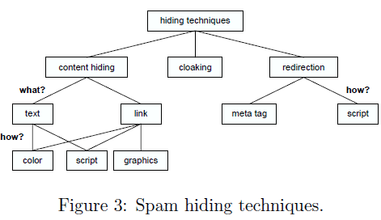
Hiding Techniques

Slide 22
Search Engines
Starting around 1996, researchers began to work on the problem. The solution was to resort to hyperlinks.
Web pages are connected to each through hyperlinks, which carry important information.
Some hyperlinks: organize information at the same site.
Other hyperlinks: point to pages from other Web sites.
Such out-going hyperlinks often indicate an implicit conveyance of authority to the pages being pointed to.
Those pages that are pointed to by many other
pages are likely to contain authoritative information.

Slide 23
Link Analysis
Newer search engines try to exploit the link structure of the Web − link analysis.
The first web search engine to apply link analysis was Google, although almost all current web search engines make use of it.
War between search engines and spammers is far from over as spammers now invest considerable effort in trying to manipulate the link structure too, which is now termed link spam.

Slide 24
Google - Link Analysis
One of the key concepts for improving Web search is to analyze the hyperlinks and the graph structure of the Web.
Link analysis is one of the factors used by web search engines to compute a score for any web page on any given query.
PageRank is a method for rating the web pages objectively and mechanically using the link structure of the web.
HITS is another algorithm that attempts the same

Slide 25
PageRank: The “Flow” Formulation

Slide 27
Web as a Graph
Web as a directed graph:
Nodes: Webpages
Edges: Hyperlinks
I teach a class on Networks.
CS224W: Classes are in the Gates building
Computer Science Department at Stanford
Stanford University

Slide 28
Web as a Graph
Web as a directed graph:
Nodes: Webpages
Edges: Hyperlinks
I teach a class on Networks.
CS224W: Classes are in the Gates building
Computer Science Department at Stanford
Stanford University

Slide 29
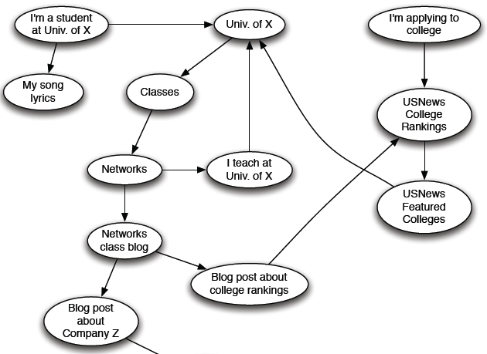
Web as a Directed Graph

Slide 30
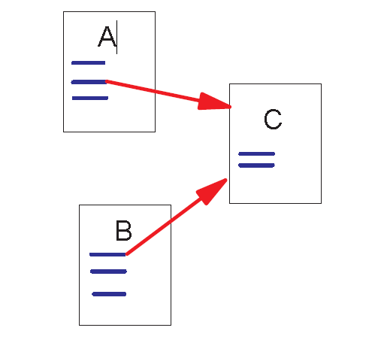
Link Structure of the Web
300 million web pages → 3.5 billion links
Backlinks and Forward links:
A and B are C’s backlinks
C is A and B’s forward link
Google ranks pages based on two factors
Intuitively, a webpage is important if it has a lot of backlinks.
Concept of a Random Surfer

Slide 31
Random Surfer Model
Consider a random surfer who begins at a web page (a node of the web graph) and executes a random walk on the Web as follows.
At each time step, the surfer proceeds from his current page A to a randomly chosen web page that A has hyperlinks to.
Surfer proceeds from node to node, some nodes will be visited more often than others; intuitively, these are nodes with many links coming in from other frequently visited nodes.
As an extension to this idea, consider a set of such random surfers and after a period of time find which pages had large number of surfers visiting it.
The idea of PageRank is that pages with large number of visits are more important than those with few visits.

Slide 32
Weighting of Pages
The ranking of a web page is not dependent only on terms appearing on that page, but some weightage is also given to the terms used in or near the links to that page.
In Google’s own words:
PageRank works by counting the number and quality of links to a page to determine a rough estimate of how important the website is.
The underlying assumption is that more important websites are likely to receive more links from other websites.

Slide 33
Links as Votes
Idea: Links as votes
Page is more important if it has more links
In-coming links? Out-going links?
Think of in-links as votes:
www.stanford.edu has 23,400 in-links
www.community-college.com has 1 in-link
Are all in-links are equal?
Links from important pages count more

Slide 34
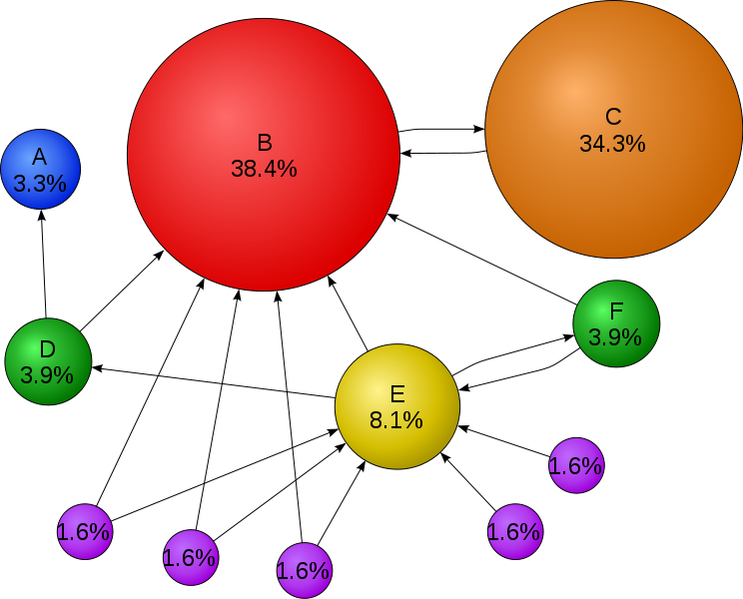
PageRank.
Not all votes are equally “important”
Important pages propagate more authority
Intuitive: A web page is important if it is pointed to by other important pages.
Quantity & Quality
B is important.
C is also important.
Notes:
http://en.wikipedia.org/wiki/PageRank

Slide 35
Simple Recursive Formulation
Each link’s vote is proportional to the importance of its source page
If page j with importance r_{j} has n out-links, each link gets r_{j} / n votes
Page j’s own importance is the sum of the votes on its in-links
i
k
r_{i}/3
r_{k}/4
r_{j} = r_{i}/3+r_{k}/4
j
r_{j}/3
r_{j}/3
r_{j}/3

Slide 36
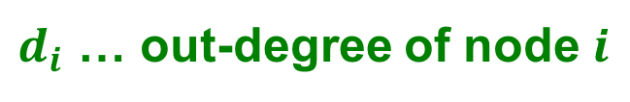
PageRank: The “Flow” Model
A “vote” from an important page is worth more
A page is important if it is pointed to by other important pages
Define a “rank” r_{j} for page j
y/2
y
a/2
y/2
m
a
m
a/2
“Flow” equations:
r_{y} = r_{y} /2 + r_{a} /2
r_{a} = r_{y} /2 + r_{m}
r_{m} = r_{a} /2
$d_{i}$ … out-degree of node $i$

Slide 37
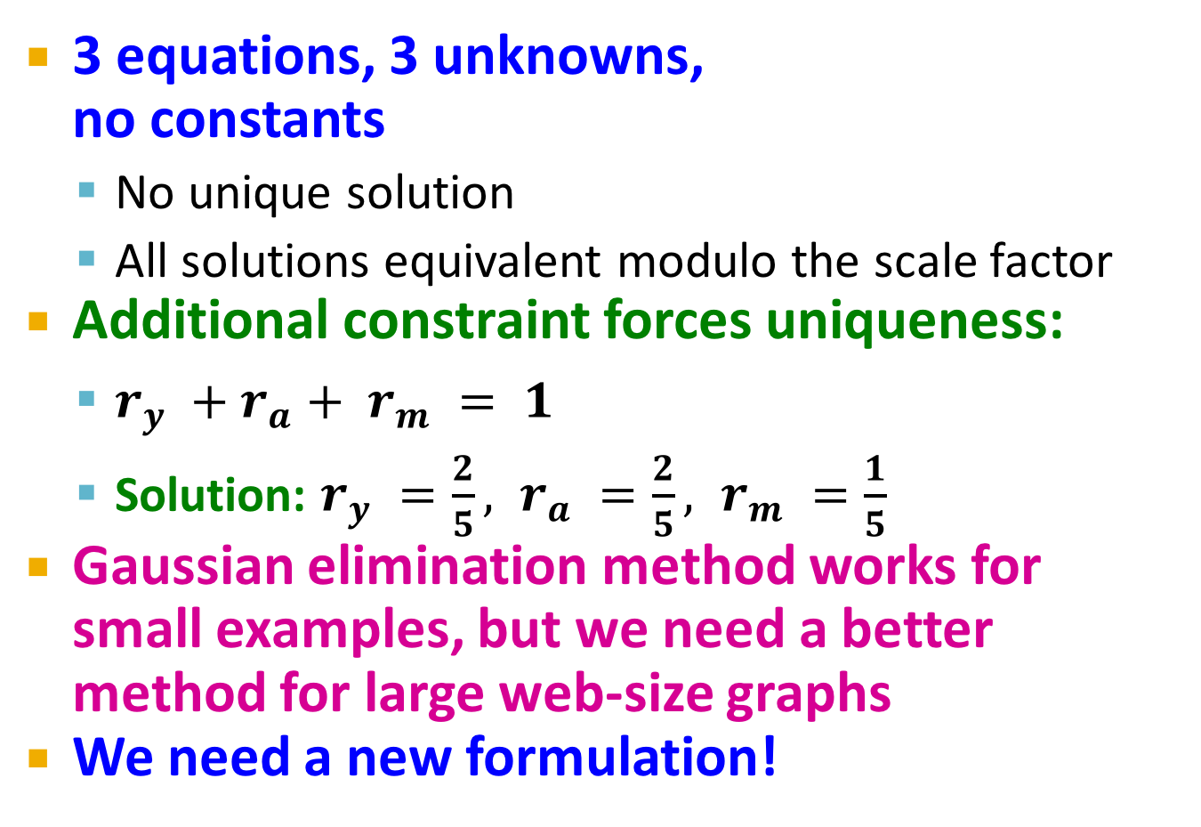
Solving the Flow Equations
Flow equations:
3 equations, 3 unknowns, no constants
No unique solution
All solutions equivalent modulo the scale factor
Additional constraint forces uniqueness:
$r_{y} +r_{a}+ r_{m} = 1$
Solution: $r_{y} =\frac{2}{5}, r_{a} =\frac{2}{5}, r_{m} =\frac{1}{5}$
Gaussian elimination method works for small examples, but we need a better method for large web-size graphs
We need a new formulation!
r_{y} = r_{y} /2 + r_{a} /2
r_{a} = r_{y} /2 + r_{m}
r_{m} = r_{a} /2

Slide 38

Illustrative Example
Surfer at a node 1 can proceed to 3 or 5 with probabilities 1/2.
Surfer has zero probability of reaching 2 and 4.
Create a “Transition Matrix” “M” , to indicate the probability of a random surfer reaching that node from the current node.
The matrix M is an n × n matrix if there are n web pages. For a web page pair (P_{i},P_{j}) the corresponding entry in M (row i column j) is
1
2
5
3
4

Slide 39
Transition Matrix
k is the number of outlinks from P_{j} and one of these is to page P_{i}
otherwise
M(i ,j) = 0

Slide 40
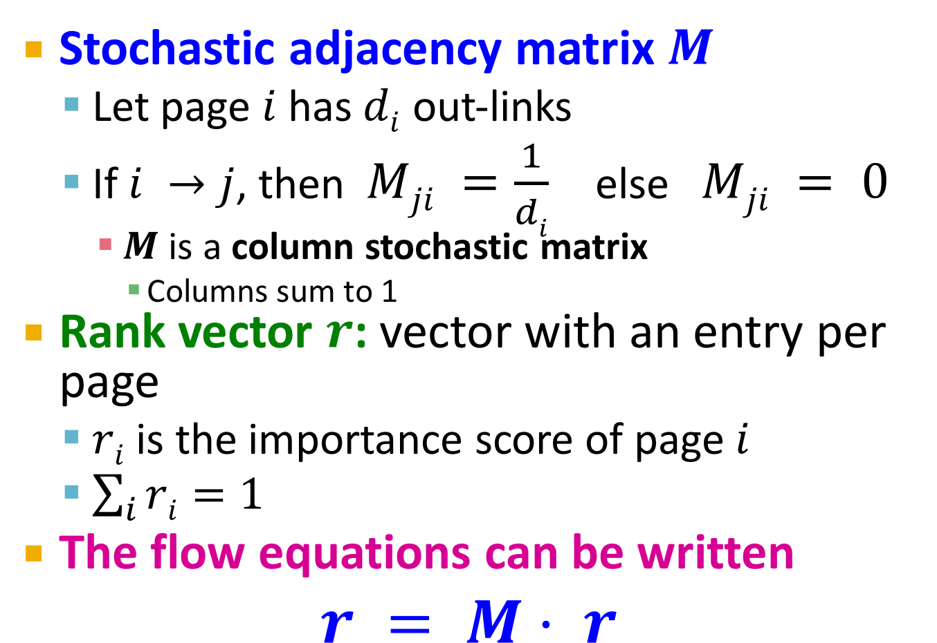
PageRank: Matrix Formulation
Stochastic adjacency matrix $M$
Let page $i$ has $di$ out-links
If $i →j$, then $Mji =\frac{1}{di}$ else $Mji = 0$
$M$ is a column stochastic matrix
Columns sum to 1
Rank vector $r$: vector with an entry per page
$ri$ is the importance score of page $i$
$\sum_{i}{ri=1}$
The flow equations can be written $r = M⋅ r$

Slide 41
Example: Flow Equations & M
 | y | a | m
y | ½ | ½ | 0
a | ½ | 0 | 1
m | 0 | ½ | 0
y
a
m
r_{y} = r_{y} /2 + r_{a} /2
r_{a} = r_{y} /2 + r_{m}
r_{m} = r_{a} /2
r = M∙r
y ½ ½ 0 y
a = ½ 0 1 a
m 0 ½ 0 m

Slide 42
Power Iteration Method
Given a web graph with n nodes, where the nodes are pages and edges are hyperlinks
Power iteration: a simple iterative scheme
Suppose there are N web pages
Initialize: r⁽⁰⁾ = [1/N,….,1/N]^{T}
Iterate: r^{(t+1)} = M ∙ r^{(t)}
Stop when |r^{(t+1)} – r^{(t)}|₁ < ε
d_{i} …. out-degree of node i
|x|₁ = ∑_{1≤i≤N}|x_{i}| is the L1 norm
Can use any other vector norm, e.g., Euclidean

Slide 43
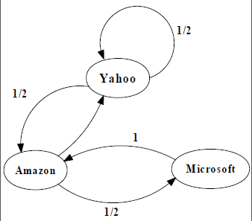
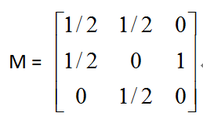
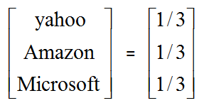
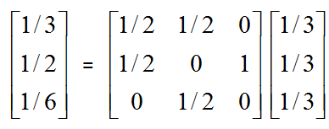
An example of Simplified PageRank
PageRank Calculation: first iteration

Slide 44
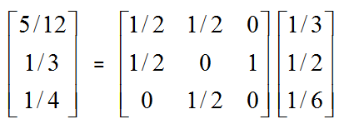
An example of Simplified PageRank
PageRank Calculation: second iteration

Slide 45
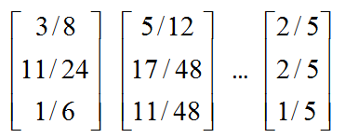
An example of Simplified PageRank
Convergence after some iterations

Slide 46
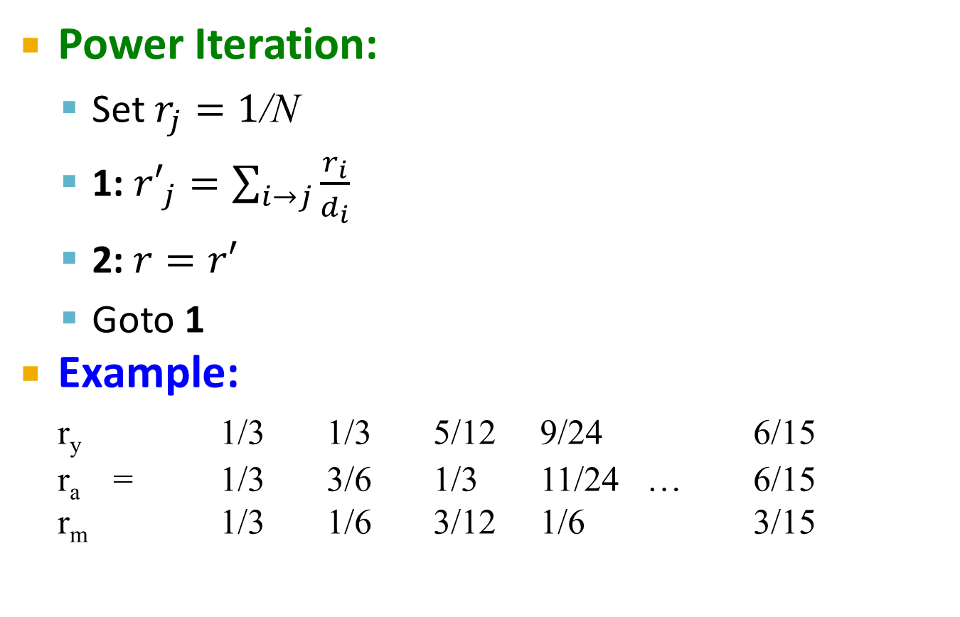
PageRank: How to solve?
Power Iteration:
Set $r_{j}=1$/N
1: ${r′}_{j}=\sum_{i→j}{\frac{r_{i}}{d_{i}}}$
2:$r=r′$
Goto 1
Example:
r_{y} 1/3 1/3 5/12 9/24 6/15
r_{a} = 1/3 3/6 1/3 11/24 … 6/15
r_{m} 1/3 1/6 3/12 1/6 3/15
y
 | y | a | m
y | ½ | ½ | 0
a | ½ | 0 | 1
m | 0 | ½ | 0
a
m
r_{y} = r_{y} /2 + r_{a} /2
r_{a} = r_{y} /2 + r_{m}
r_{m} = r_{a} /2
Iteration 0, 1, 2, …

Slide 47
PageRank: How to solve?
Power Iteration:
Set $r_{j}=1$/N
1: ${r′}_{j}=\sum_{i→j}{\frac{r_{i}}{d_{i}}}$
2:$r=r′$
Goto 1
Example:
r_{y} 1/3 1/3 5/12 9/24 6/15
r_{a} = 1/3 3/6 1/3 11/24 … 6/15
r_{m} 1/3 1/6 3/12 1/6 3/15
y
 | y | a | m
y | ½ | ½ | 0
a | ½ | 0 | 1
m | 0 | ½ | 0
a
m
r_{y} = r_{y} /2 + r_{a} /2
r_{a} = r_{y} /2 + r_{m}
r_{m} = r_{a} /2
Iteration 0, 1, 2, …

Slide 48
For Our Example
Thus Page 1 has PageRank 0.4313 as does Page 2.
Pages 3 and 4 have PageRank 0.3235
Page 5 has the highest PageRank of 0.6470.

Slide 49
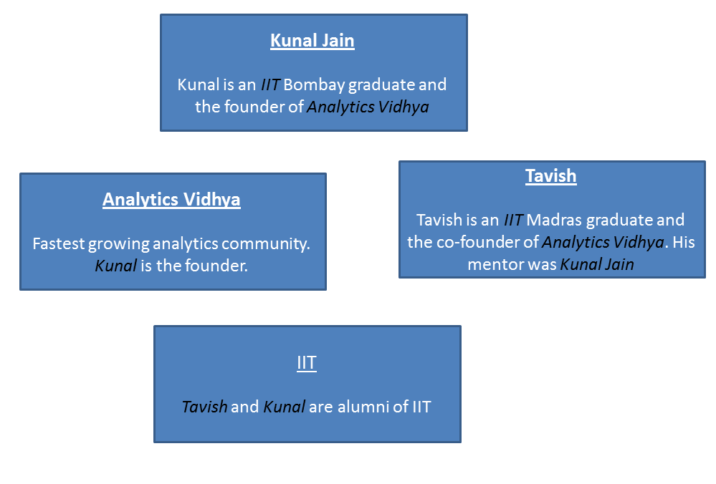
One more Example

Slide 50
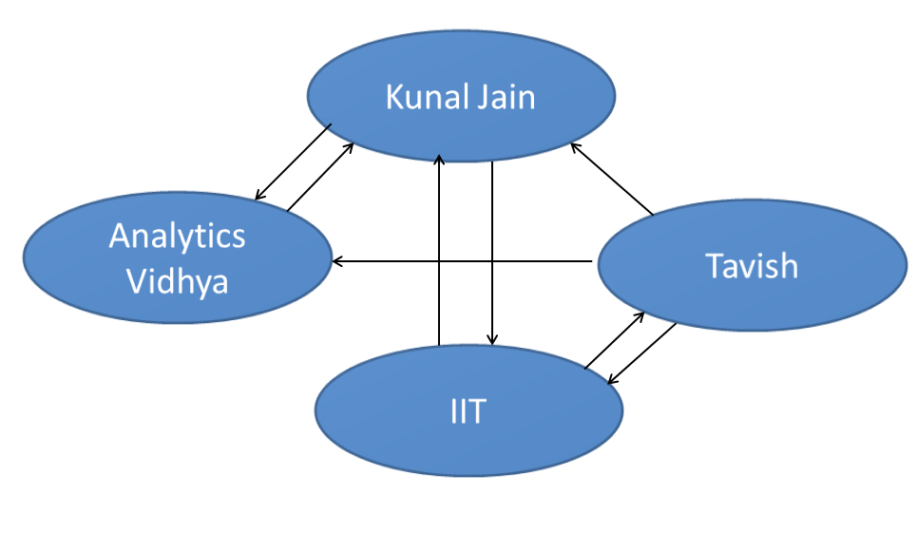
Web Graph

Slide 51
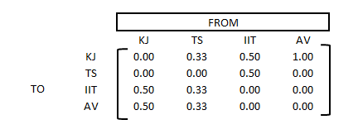
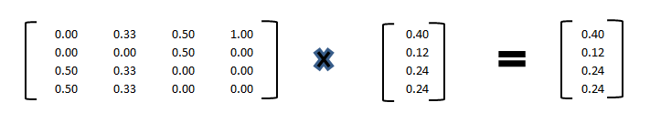
PageRank

Slide 52
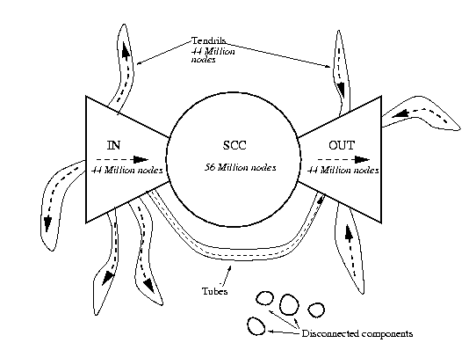
Bowtie Structure of the Web
Strongly Connected Component
Broder et al., 2001

Slide 53
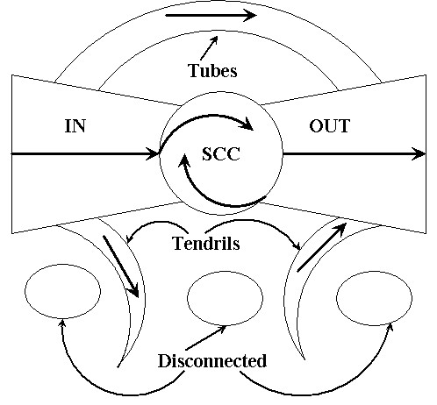
Bowtie Model of the Web
Broder et al. 2001 – crawl of over 200 million pages and 1.5 billion links.
SCC – 27.5%
IN and OUT – 21.5%
Tendrils and tubes – 21.5%
Disconnected – 8%

Slide 54
Bowtie Structure
Sites that link towards the ‘center’ of the web
Broder et al., 2001

Slide 55
Bowtie Structure
Sites that link from the ‘center’ of the web
Broder et al., 2001

Slide 56
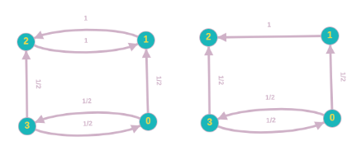
PageRank: 2 Problems
1. Dead ends
Some pages have no out-links
Random walk has “nowhere” to go to
Such pages cause importance to “leak out”
(2) Spider traps: all out-links are within the group
Random walked gets “stuck” in a trap
And eventually spider traps absorb all importance
Dead end
Spider trap

Slide 57
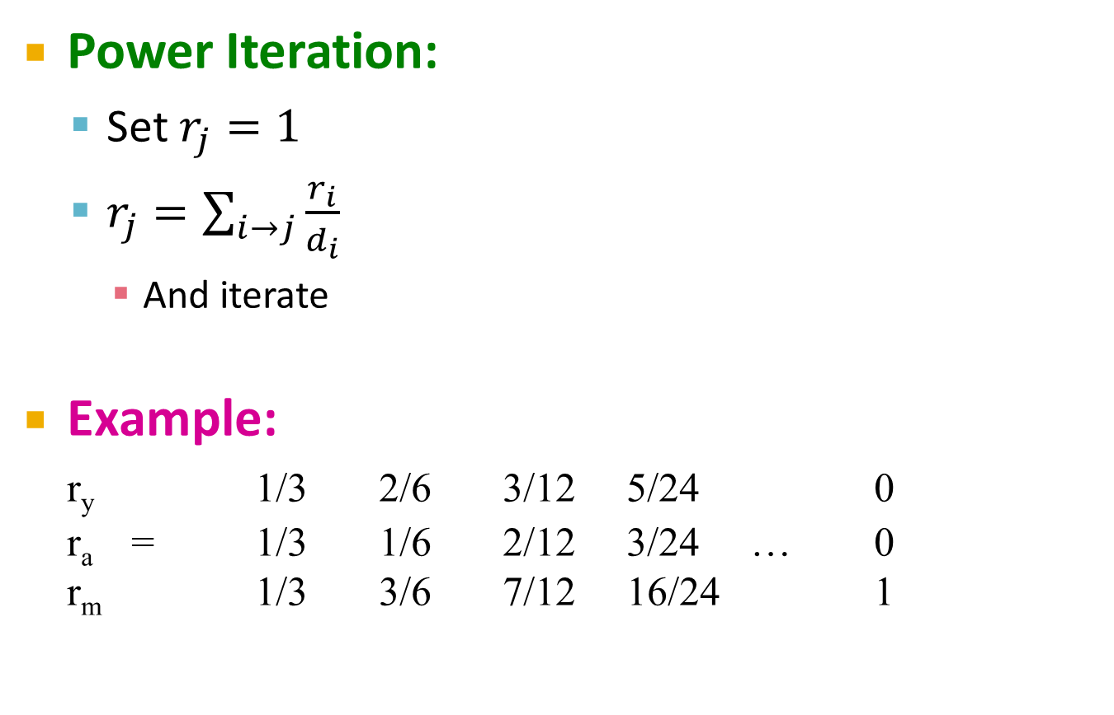
Problem: Spider Traps
Power Iteration:
Set $r_{j}=1$
$r_{j}=\sum_{i→j}{\frac{r_{i}}{d_{i}}}$
And iterate
Example:
r_{y} 1/3 2/6 3/12 5/24 0
r_{a} = 1/3 1/6 2/12 3/24 … 0
r_{m} 1/3 3/6 7/12 16/24 1
y
 | y | a | m
y | ½ | ½ | 0
a | ½ | 0 | 0
m | 0 | ½ | 1
a
m
m is a spider trap
r_{y} = r_{y} /2 + r_{a} /2
r_{a} = r_{y} /2
r_{m} = r_{a} /2 + r_{m}
Iteration 0, 1, 2, …
All the PageRank score gets “trapped” in node m.

Slide 58
Solution: Teleports!
The Google solution for spider traps: At each time step, the random surfer has two options
With prob. β, follow a link at random
With prob. 1-β, jump to some random page
Common values for β are in the range 0.8 to 0.9
Surfer will teleport out of spider trap within a few time steps
y
y
a
m
a
m

Slide 59

Problem: Dead Ends
Power Iteration:
Set $r_{j}=1$
$r_{j}=\sum_{i→j}{\frac{r_{i}}{d_{i}}}$
And iterate
Example:
r_{y} 1/3 2/6 3/12 5/24 0
r_{a} = 1/3 1/6 2/12 3/24 … 0
r_{m} 1/3 1/6 1/12 2/24 0
y
 | y | a | m
y | ½ | ½ | 0
a | ½ | 0 | 0
m | 0 | ½ | 0
a
m
r_{y} = r_{y} /2 + r_{a} /2
r_{a} = r_{y} /2
r_{m} = r_{a} /2
Iteration 0, 1, 2, …
Here the PageRank “leaks” out since the matrix is not stochastic.

Slide 60
Solution: Always Teleport!
Teleports: Follow random teleport links with probability 1.0 from dead-ends
Adjust matrix accordingly
y
y
a
m
a
m
 | y | a | m
y | ½ | ½ | 0
a | ½ | 0 | 0
m | 0 | ½ | 0
 | y | a | m
y | ½ | ½ | ⅓
a | ½ | 0 | ⅓
m | 0 | ½ | ⅓

Slide 61
Why Teleports Solve the Problem?
Why are dead-ends and spider traps a problem and why do teleports solve the problem?
Spider-traps are not a problem, but with traps PageRank scores are not what we want
Solution: Never get stuck in a spider trap by teleporting out of it in a finite number of steps
Dead-ends are a problem
The matrix is not column stochastic so our initial assumptions are not met
Solution: Make matrix column stochastic by always teleporting when there is nowhere else to go

Slide 62
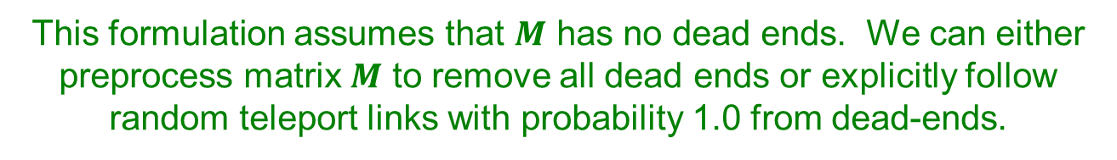
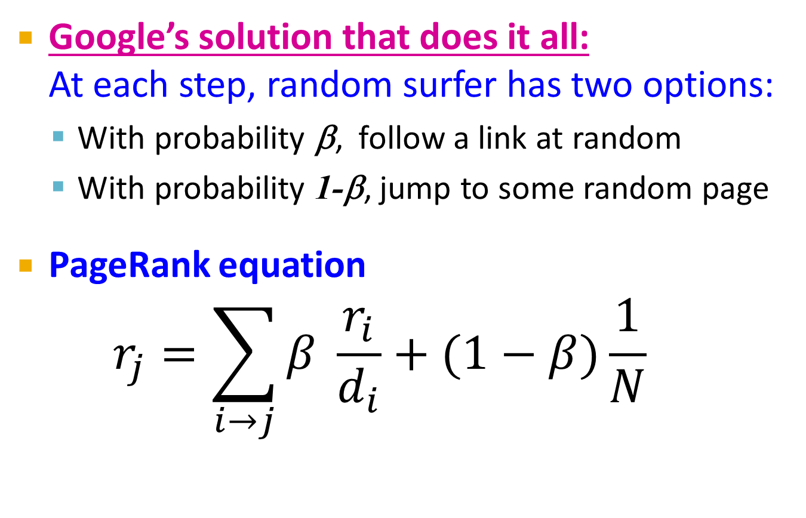
Solution: Random Teleports
Google’s solution that does it all: At each step, random surfer has two options:
With probability β, follow a link at random
With probability 1-β, jump to some random page
PageRank equation $r_{j}=\sum_{i→j}{β \frac{r_{i}}{d_{i}}}+(1−β)\frac{1}{N}$
d_{i} … out-degree of node i
This formulation assumes that $M$ has no dead ends. We can either preprocess matrix $M$ to remove all dead ends or explicitly follow random teleport links with probability 1.0 from dead-ends.

Slide 63
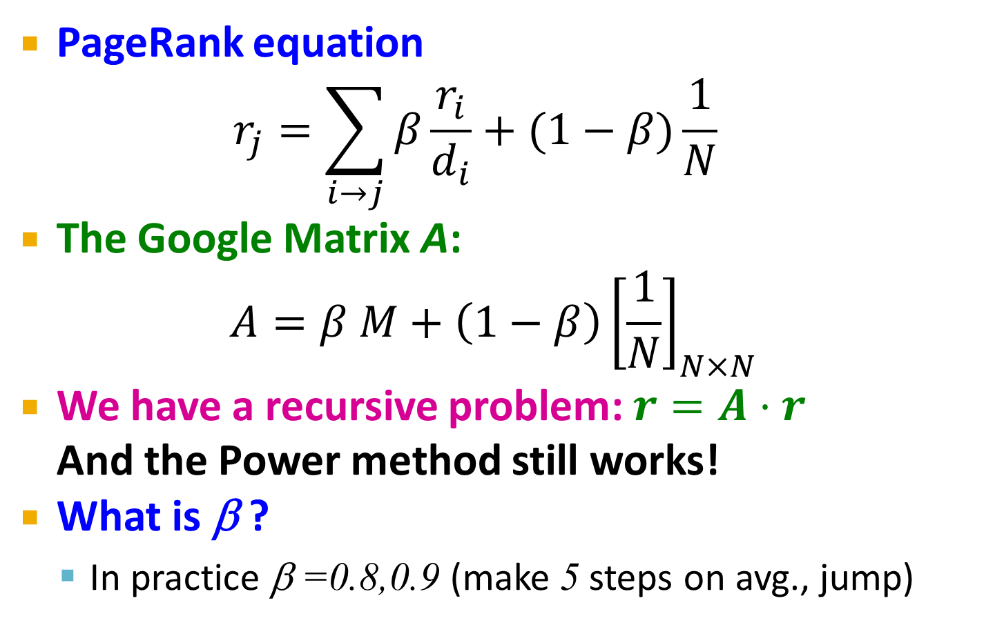
The Google Matrix
PageRank equation $r_{j}=\sum_{i→j}{β\frac{r_{i}}{d_{i}}}+(1−β)\frac{1}{N}$
The Google Matrix A:
$$A=β M+\left(1−β\right){\left[\frac{1}{N}\right]}_{N×N}$$
We have a recursive problem: $r=A⋅r$ And the Power method still works!
What is β ?
In practice β =0.8,0.9 (make 5 steps on avg., jump)
[1/N]_{NxN}…N by N matrix where all entries are 1/N

Slide 64
Random Teleports (β = 0.8)
M
[1/N]_{NxN}
7/15
y
1/2 1/2 0
1/2 0 0
0 1/2 1
1/3 1/3 1/3
1/3 1/3 1/3
1/3 1/3 1/3
0.8
+ 0.2
7/15
1/15
7/15
1/15
y 7/15 7/15 1/15
a 7/15 1/15 1/15
m 1/15 7/15 13/15
13/15
a
7/15
m
1/15
1/15
A
y
a =
m
1/3
1/3
1/3
0.33
0.20
0.46
0.24
0.20
0.52
0.26
0.18
0.56
7/33
5/33
21/33
. . .

Slide 65
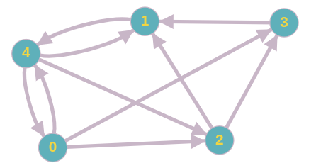
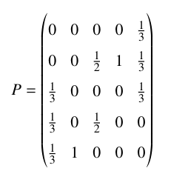
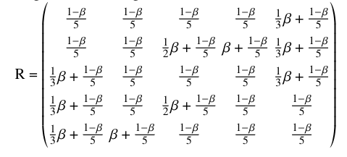
PageRank Overview (teleportation)

Slide 66
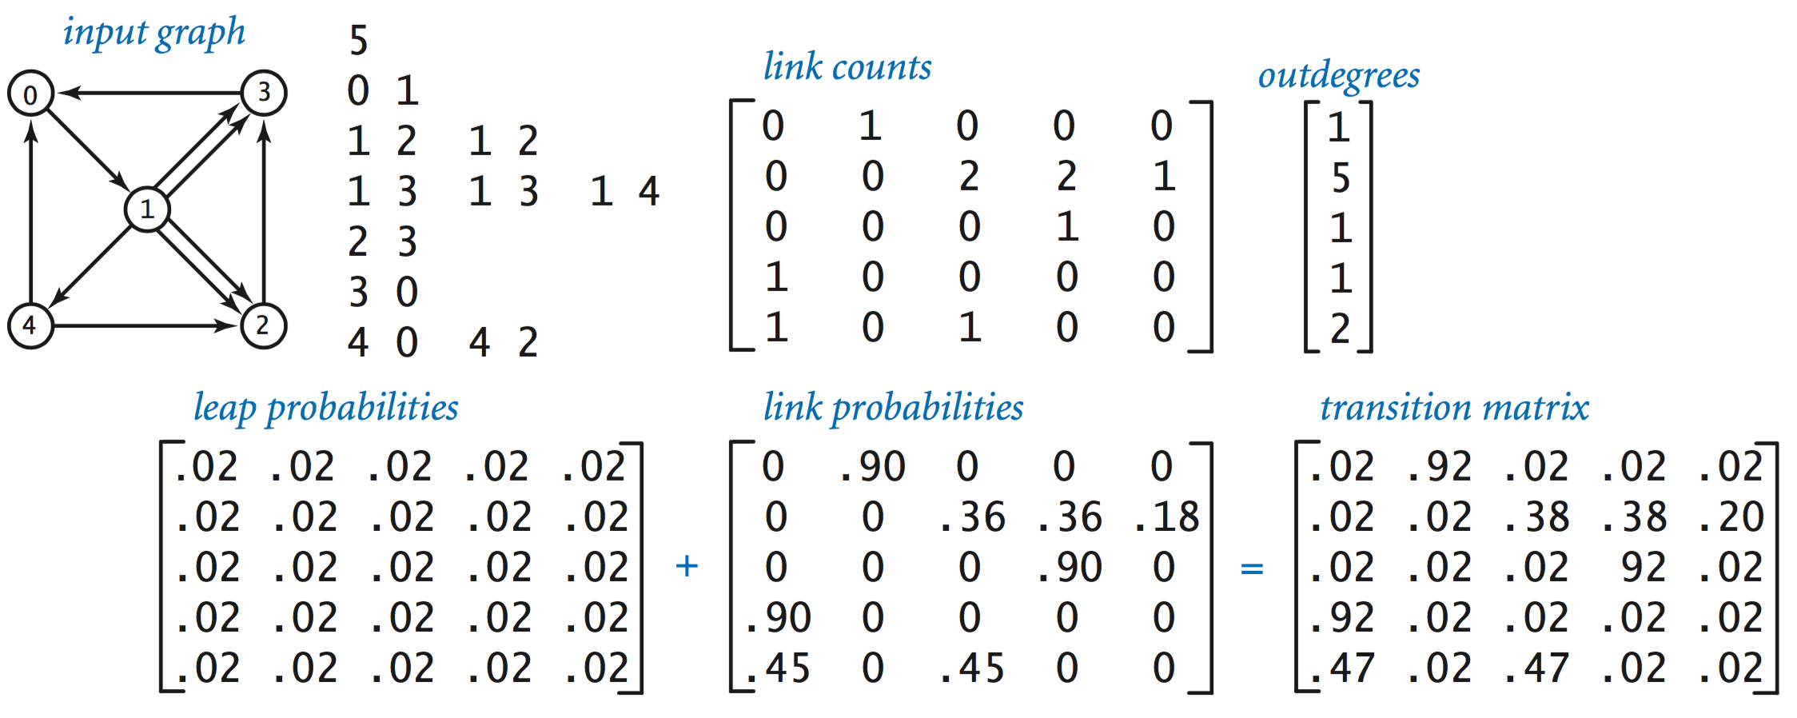
Example

Slide 67
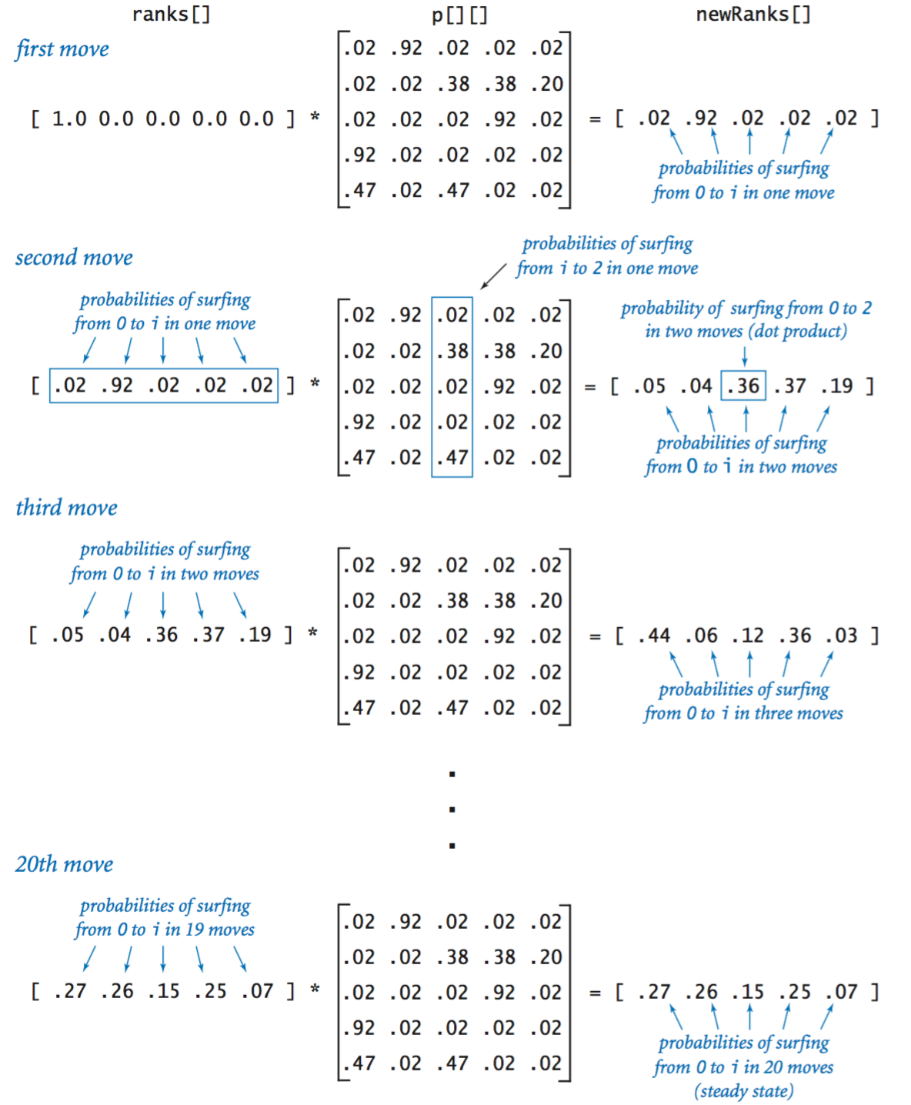

Slide 68
How do we actually compute the PageRank?

Slide 69
Computing Page Rank
Key step is matrix-vector multiplication
r^{new} = A ∙ r^{old}
Easy if we have enough main memory to hold A, r^{old}, r^{new}
Say N = 1 billion pages
We need 4 bytes for each entry (say)
2 billion entries for vectors, approx 8GB
Matrix A has N² entries
10¹⁸ is a large number!
A = β∙M + (1-β) [1/N]_{NxN}
½ ½ 0
½ 0 0
0 ½ 1
1/3 1/3 1/3
1/3 1/3 1/3
1/3 1/3 1/3
A =
0.8
+0.2
7/15 7/15 1/15
7/15 1/15 1/15
1/15 7/15 13/15
=

Slide 70
PageRank Usage

Slide 71
Some Problems with Page Rank
Measures generic popularity of a page
Biased against topic-specific authorities
Solution: Topic-Specific PageRank (next)
Uses a single measure of importance
Other models of importance
Solution: Hubs-and-Authorities
Susceptible to Link spam
Artificial link topographies created in order to boost page rank
Solution: TrustRank

Slide 72
What is Web Spam?
Spamming:
Any deliberate action to boost a web page’s position in search engine results, incommensurate with page’s real value
Spam:
Web pages that are the result of spamming
This is a very broad definition
SEO industry might disagree!
SEO = search engine optimization
Approximately 10-15% of web pages are spam

Slide 73
Web Search
Early search engines:
Crawl the Web
Index pages by the words they contained
Respond to search queries (lists of words) with the pages containing those words
Early page ranking:
Attempt to order pages matching a search query by “importance”
First search engines considered:
(1) Number of times query words appeared
(2) Prominence of word position, e.g. title, header

Slide 74
First Spammers
As people began to use search engines to find things on the Web, those with commercial interests tried to exploit search engines to bring people to their own site – whether they wanted to be there or not
Example:
Shirt-seller might pretend to be about “movies”
Techniques for achieving high relevance/importance for a web page

Slide 75
First Spammers: Term Spam
How do you make your page appear to be about movies?
(1) Add the word movie 1,000 times to your page
Set text color to the background color, so only search engines would see it
(2) Or, run the query “movie” on your target search engine
See what page came first in the listings
Copy it into your page, make it “invisible”
These and similar techniques are term spam

Slide 76
Google’s Solution to Term Spam
Believe what people say about you, rather than what you say about yourself
Use words in the anchor text (words that appear underlined to represent the link) and its surrounding text
PageRank as a tool to measure the “importance” of Web pages

Slide 77
Why It Works?
Our hypothetical shirt-seller loses
Saying he is about movies doesn’t help, because others don’t say he is about movies
His page isn’t very important, so it won’t be ranked high for shirts or movies
Example:
Shirt-seller creates 1,000 pages, each links to his with “movie” in the anchor text
These pages have no links in, so they get little PageRank
So the shirt-seller can’t beat truly important movie pages, like IMDB

Slide 78

LINK SPAM-
SPAM FARMING

Slide 79
Google vs. Spammers: Round 2!
Once Google became the dominant search engine, spammers began to work out ways to fool Google
Spam farms were developed to concentrate PageRank on a single page
Link spam:
Creating link structures that boost PageRank of a particular page

Slide 80
Link Spam - Overview
Link spam is the posting of out-of-context links on websites, discussion forums, blog comments, guestbooks or any other online venue that displays user comments.
The purpose of link spam is to increase the number of external links made to a site the spammer wishes to promote. A greater number of links made to a page, among other things, increases a page’s rank
Link spam started in website guestbooks, where the spammer would repeatedly paste links to the site they were promoting. Around 2003, spammers began to attack open comments in blogs.

Slide 81
Link Spam - Overview
Currently, many blog software systems have ways of eliminating or minimizing link spam.
Because common targets were being protected, spammers began looking elsewhere, such as wikis. As a result, wikispam was born. Many wikis, including Wikipedia, have pages in their sandbox testing areas filled with spammed links, along with active pages that are defaced by links.
Link spamming can backfire on the perpetrator when search engines decide a site is a bad neighbor and remove it from search results altogether.

Slide 82
Link Spamming
Three kinds of web pages from a spammer’s point of view
Inaccessible pages
Accessible pages
e.g., blog comments pages
spammer can post links to his pages
Owned pages
Completely controlled by spammer
May span multiple domain names

Slide 83
Link Farms
A link farm (also called link network) is a domain or website, which was specially created by spammers to provide links to other websites in order to influence the rankings for the linked webpages.
Spammer’s goal:
Maximize the PageRank of target page t
Technique:
Get as many links from accessible pages as possible to target page t
Construct “link farm” to get PageRank multiplier effect

Slide 84
Link Farms
Accessible
Owned
Inaccessible
1
t
2
M
Millions of farm pages
One of the most common and effective organizations for a link farm

Slide 85
Analysis
Accessible
Owned
Inaccessible
1
t
2
N…# pages on the web
M…# of pages spammer owns
M
x: PageRank contributed by accessible pages
y: PageRank of target page t
Rank of each “farm” page $=\frac{βy}{M}+\frac{1−β}{N}$
$y=x+βM\left[\frac{βy}{M}+\frac{1−β}{N}\right]+\frac{1−β}{N}$
$=x+β^{2}y+\frac{β\left(1−β\right)M}{N}+\frac{1−β}{N}$
$y=\frac{x}{1−β^{2}}+c\frac{M}{N}$ where $c=\frac{β}{1+β}$
Very small; ignore Now we solve for y

Slide 86
Analysis
Accessible
Owned
Inaccessible
1
t
2
N…# pages on the web
M…# of pages spammer owns
M
$y=\frac{x}{1−β^{2}}+c\frac{M}{N}$ where $c=\frac{β}{1+β}$
For β = 0.85, 1/(1-β²)= 3.6
Multiplier effect for acquired PageRank
By making M large, we can make y as large as we want

Slide 87
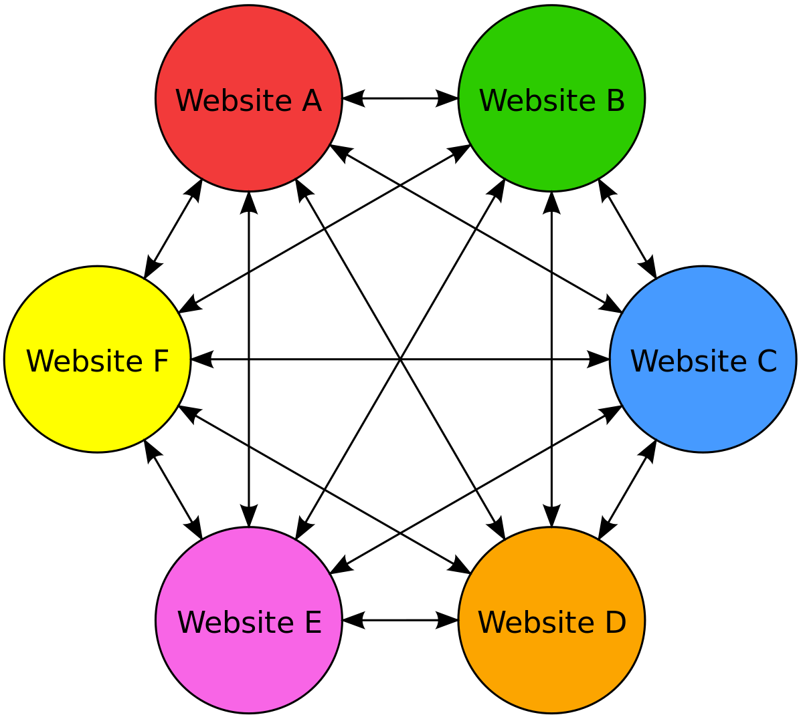
Example Link Farm - Blog network
A private blog network (PBN), also known as a link farm, is a group of blogs that are owned by the same entity.
A blog network can either be a group of loosely connected blogs, or a group of blogs that are owned by the same company.
The purpose of such a network is usually to promote the other blogs in the same network and therefore increase the search engine rankings or advertising revenue generated from online advertising on the blogs.
In September 2014, Google targeted private blog networks (PBNs) with manual action ranking penalties.

Slide 88
Combating Spam
Combating term spam
Analyze text using statistical methods
Similar to email spam filtering
Also useful: Detecting approximate duplicate pages
Combating link spam
Detection and blacklisting of structures that look like spam farms
Leads to another war – hiding and detecting spam farms
TrustRank = PageRank with a teleport set of trusted pages
Example: .edu domains, similar domains for non-US schools

Slide 89
TrustRank: Idea
Basic principle: Approximate isolation
It is rare for a “good” page to point to a “bad” (spam) page
Sample a set of seed pages from the web
Have an oracle (human) to identify the good pages and the spam pages in the seed set
Expensive task, so we must make seed set as small as possible

Slide 90
Trust Propagation
Call the subset of seed pages that are identified as good the trusted pages
Perform a PageRank with teleport set = trusted pages
Propagate trust through links:
Each page gets a trust value between 0 and 1
Solution 1: Use a threshold value and mark all pages below the trust threshold as spam

Slide 91
Spam Mass
In the TrustRank model, we start with good pages and propagate trust
Complementary view:
What fraction of a page’s PageRank comes from spam pages?
In practice, we don’t know all the spam pages, so we need to estimate
Trusted set
Web

Slide 92
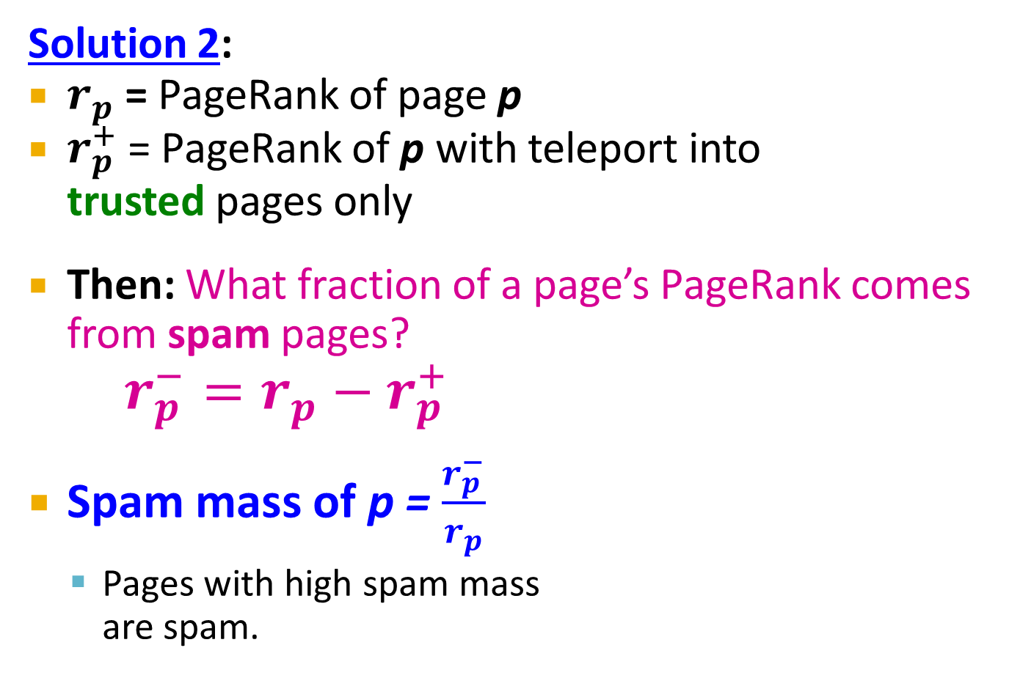
Spam Mass Estimation
Solution 2:
$r_{p}$ = PageRank of page p
$r_{p}^{+}$ = PageRank of p with teleport into trusted pages only
Then: What fraction of a page’s PageRank comes from spam pages?
$r_{p}^{−}=r_{p}−r_{p}^{+}$
Spam mass of p = $\frac{r_{p}^{−}}{r_{p}}$
Pages with high spam mass are spam.
Trusted set
Web

Slide 93
HITS: Hubs and Authorities

Slide 94
Hubs and Authorities
HITS (Hypertext-Induced Topic Selection)
Is a measure of importance of pages or documents, similar to PageRank
Proposed at around same time as PageRank (‘98)
Goal: Say we want to find good newspapers
Don’t just find newspapers. Find “experts” – people who link in a coordinated way to good newspapers
Idea: Links as votes
Page is more important if it has more links
In-coming links? Out-going links?

Slide 95
Finding newspapers
Hubs and Authorities Each page has 2 scores:
Quality as an expert (hub):
Total sum of votes of authorities pointed to
Quality as a content (authority):
Total sum of votes coming from experts
Principle of repeated improvement
NYT: 10
Ebay: 3
Yahoo: 3
CNN: 8
WSJ: 9

Slide 96
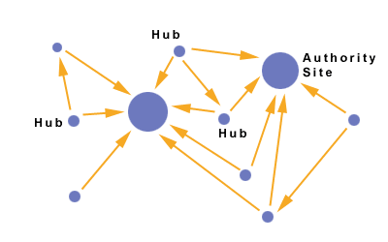
Hubs and Authorities
Interesting pages fall into two classes:
Authorities are pages containing useful information
Newspaper home pages
Course home pages
Home pages of auto manufacturers
Hubs are pages that link to authorities
List of newspapers
Course bulletin
List of US auto manufacturers

Slide 97
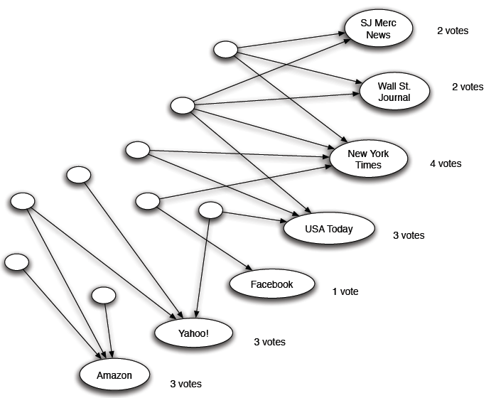
Counting in-links: Authority
Each page starts with hub score 1. Authorities collect their votes
(Note this is idealized example. In reality graph is not bipartite and each page has both the hub and authority score)

Slide 98
Counting in-links: Authority
Sum of hub scores of nodes pointing to NYT.
Each page starts with hub score 1. Authorities collect their votes
(Note this is idealized example. In reality graph is not bipartite and each page has both the hub and authority score)

Slide 99
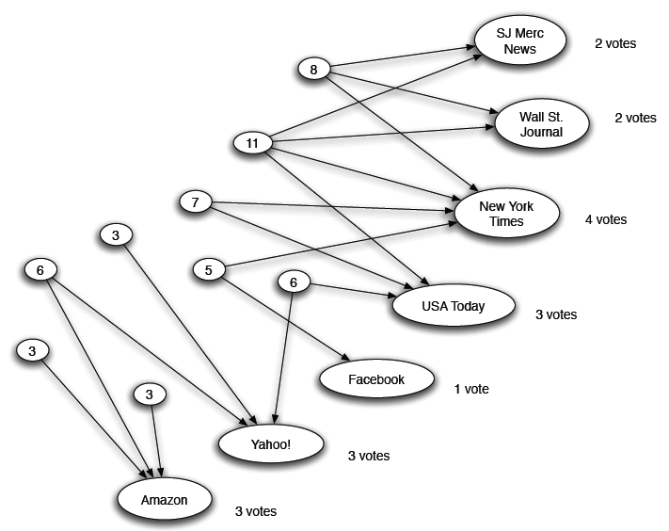
Expert Quality: Hub
Sum of authority scores of nodes that the node points to.
Hubs collect authority scores
(Note this is idealized example. In reality graph is not bipartite and each page has both the hub and authority score)

Slide 100
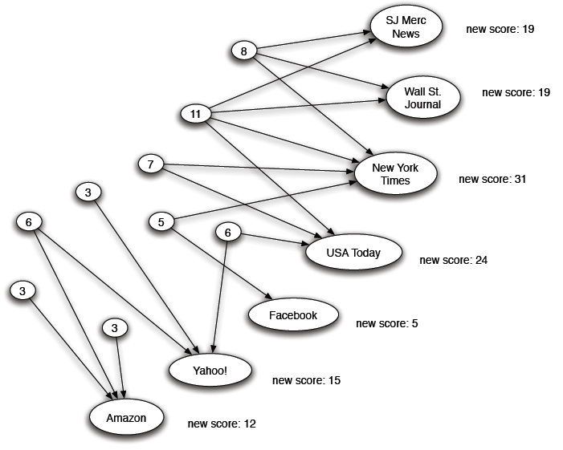
Reweighting
Authorities again collect the hub scores
(Note this is idealized example. In reality graph is not bipartite and each page has both the hub and authority score)

Slide 101
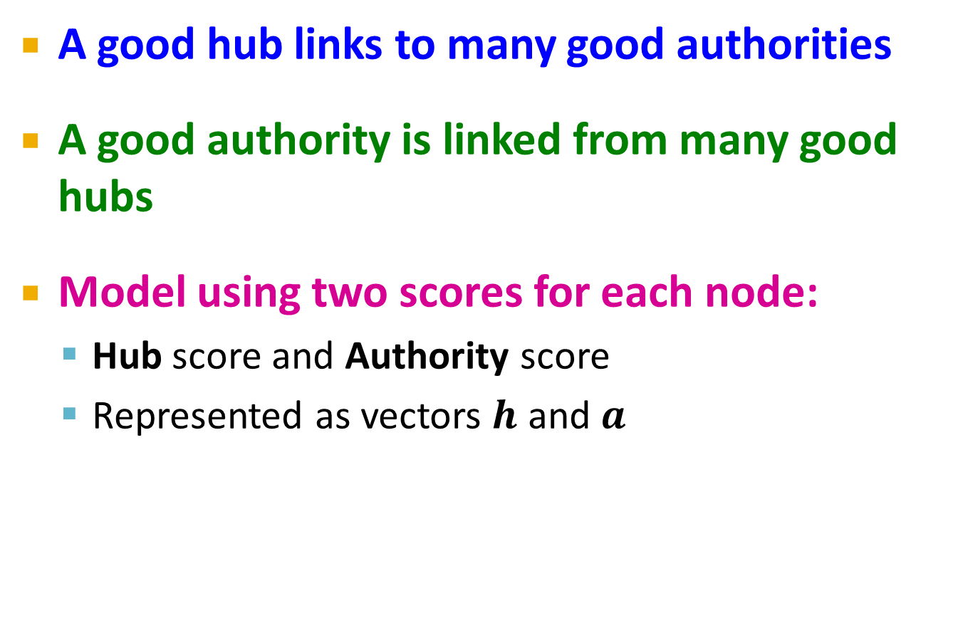
Mutually Recursive Definition
A good hub links to many good authorities
A good authority is linked from many good hubs
Model using two scores for each node:
Hub score and Authority score
Represented as vectors $h$ and $a$

Slide 102
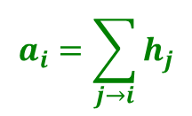
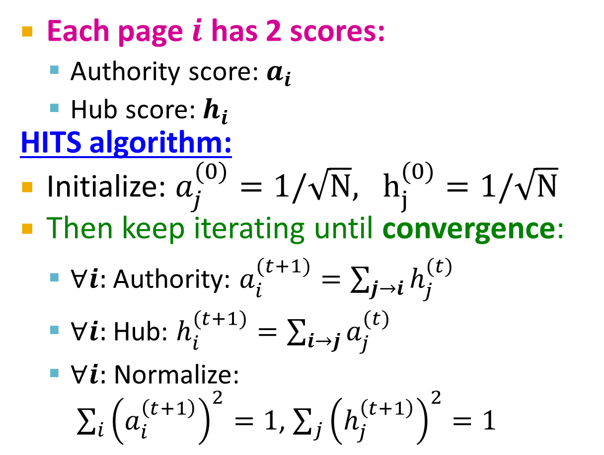
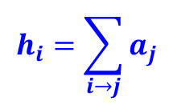
Hubs and Authorities
[Kleinberg ‘98]
j₁
j₂
j₃
j₄
Each page $i$ has 2 scores:
Authority score: $a_{i}$
Hub score: $h_{i}$
HITS algorithm:
Initialize: $a_{j}^{(0)}=1/\sqrt{N}, h_{j}^{(0)}=1/\sqrt{N}$
Then keep iterating until convergence:
$∀i:$Authority: $a_{i}^{(t+1)}=\sum_{j→i}{h_{j}^{(t)}}$
$∀i:$Hub: $h_{i}^{(t+1)}=\sum_{i→j}{a_{j}^{(t)}}$
$∀i:$ Normalize: $\sum_{i}{{\left(a_{i}^{\left(t+1\right)}\right)}^{2}}=1$, $\sum_{j}{{\left(h_{j}^{\left(t+1\right)}\right)}^{2}}=1$
i
$$a_{i}=\sum_{j→i}{h_{j}}$$
i
j₁
j₂
j₃
j₄
$$h_{i}=\sum_{i→j}{a_{j}}$$

Slide 103
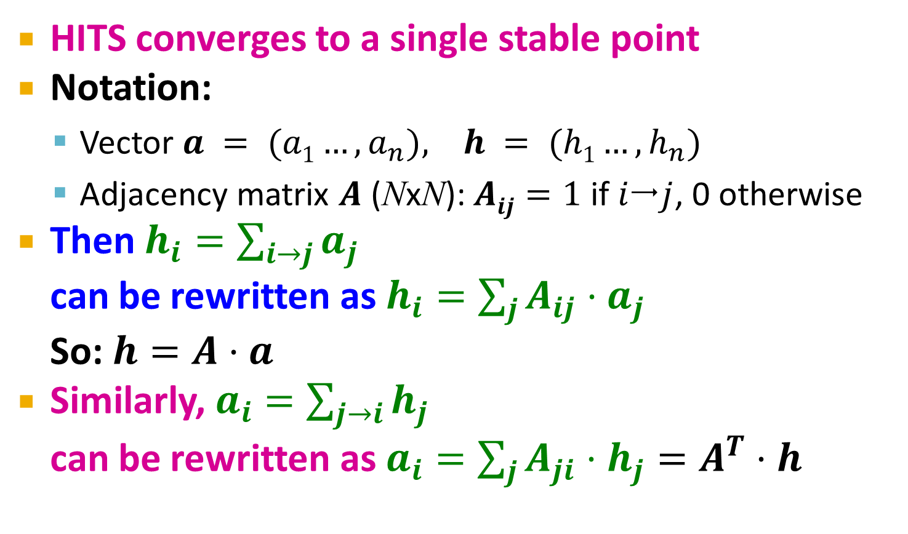
Hubs and Authorities
[Kleinberg ‘98]
HITS converges to a single stable point
Notation:
Vector $a = (a1…,a_{n}), h = (h1…,h_{n})$
Adjacency matrix $A$ (NxN): $Aij=1$ if $ij$, 0 otherwise
Then $h_{i}=\sum_{i→j}{a_{j}}$ can be rewritten as $h_{i}=\sum_{j}{A_{ij}⋅a_{j}}$ So: $h=A⋅a$
Similarly, $a_{i}=\sum_{j→i}{h_{j}}$ can be rewritten as $a_{i}=\sum_{j}{A_{ji}⋅h_{j}}=A^{T}⋅h$

Slide 104

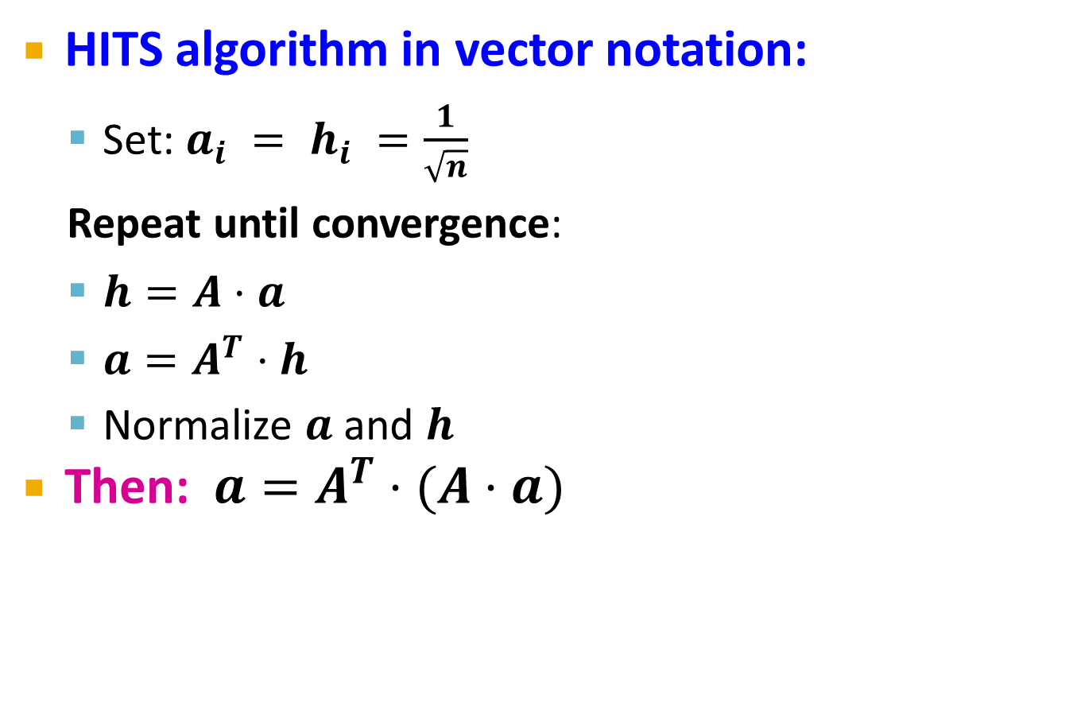
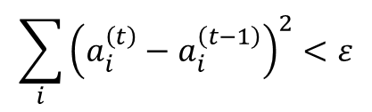
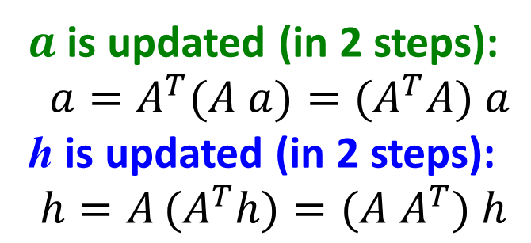
Hubs and Authorities
HITS algorithm in vector notation:
Set: $a_{i} = h_{i} =\frac{1}{\sqrt{n}}$
Repeat until convergence:
$h=A⋅a$
$a=A^{T}⋅h$
Normalize $a$ and $h$
Then: $a=A^{T}⋅(A⋅a)$
Convergence criterion:
$$\sum_{i}{{\left(a_{i}^{\left(t\right)}−a_{i}^{\left(t−1\right)}\right)}^{2}}<ε$$
$a$ is updated (in 2 steps):
$a=A^{T}(A a)=(A^{T}A) a$
h is updated (in 2 steps):
$$h=A (A^{T}h)=(A{ A}^{T}) h$$
new $a$
Repeated matrix powering

Slide 105
Existence and Uniqueness
h = λ A a
a = μ A^{T} h
h = λ μ A A^{T} h
a = λ μ A^{T} A a
Under reasonable assumptions about A, HITS converges to vectors h* and a*:
h* is the principal eigenvector of matrix A A^{T}
a* is the principal eigenvector of matrix A^{T} A
λ = 1 / ∑h_{i}
μ = 1 / ∑a_{i}

Slide 106
Example of HITS
1 1 1
A = 1 0 1
0 1 0
1 1 0
A^{T} = 1 0 1
1 1 0
Yahoo
Amazon
M’soft
h(yahoo)
h(amazon)
h(m’soft)
=
=
=
.58
.58
.58
.80
.53
.27
.80
.53
.27
.79
.57
.23
. . .
. . .
. . .
.788
.577
.211
a(yahoo) = .58
a(amazon) = .58
a(m’soft) = .58
.58
.58
.58
.62
.49
.62
.62
.49
.62
. . .
. . .
. . .
.628
.459
.628

Slide 107
Overview HITS
Let number of iterations be k.
Each node is assigned a Hub score = 1 and an Authority score = 1.
Repeat k times:
Hub update : Each node’s Hub score =
Σ(Authority score of each node it points to).
Authority update : Each node’s Authority score =
Σ(Hub score of each node pointing to it).
Normalize the scores by dividing each Hub score by square root of the sum of the squares of all Hub scores, and dividing each Authority score by square root of the sum of the squares of all Authority scores. (optional)

Slide 108
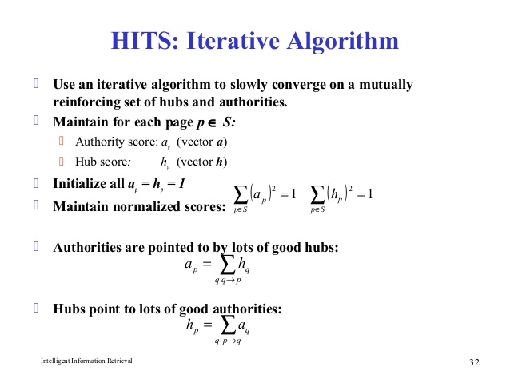

Slide 109
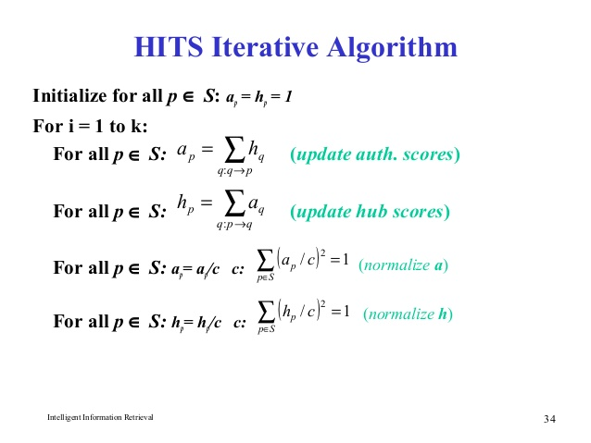

Slide 110
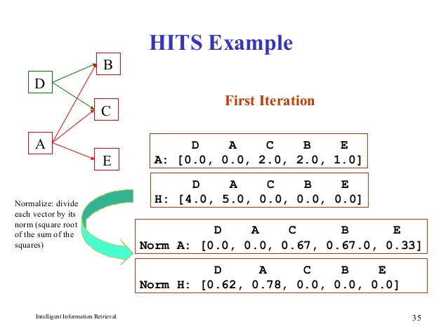

Slide 111
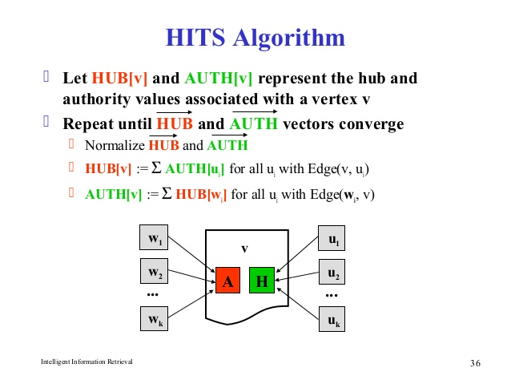

Slide 112


Slide 113


Slide 117
PageRank and HITS
PageRank and HITS are two solutions to the same problem:
What is the value of an in-link from u to v?
In the PageRank model, the value of the link depends on the links into u
In the HITS model, it depends on the value of the other links out of u
The destinies of PageRank and HITS post-1998 were very different

Slide 118
PageRank with Map Reduce

Slide 119
PageRank: Defined
Given page x with inlinks t1…tn, where
C(t) is the out-degree of t
α is probability of random jump
N is the total number of nodes in the graph

Slide 120
Computing PageRank
Properties of PageRank
Can be computed iteratively
Effects at each iteration are local
Sketch of algorithm:
Start with seed PR_{i} values
Each page distributes PR_{i} “credit” to all pages it links to
Each target page adds up “credit” from multiple in-bound links to compute PR_{i+1}
Iterate until values converge

Slide 121
Simplified PageRank
First, tackle the simple case:
No random jump factor
No dangling links
Then, factor in these complexities…
Why do we need the random jump?
Where do dangling links come from?

Slide 122
Sample PageRank Iteration (1)
Iteration 1
n₂ (0.166)
n₂ (0.2)
n₁ (0.066)
n₁ (0.2)
0.1
0.1
0.1
0.1
0.066
0.066
0.066
n₅ (0.3)
n₅ (0.2)
n₃ (0.166)
n₃ (0.2)
0.2
0.2
n₄ (0.3)
n₄ (0.2)

Slide 123
Sample PageRank Iteration (2)
Iteration 2
n₂ (0.133)
n₂ (0.166)
n₁ (0.1)
0.033
0.083
n₁ (0.066)
0.083
0.033
0.1
0.1
0.1
n₅ (0.383)
n₅ (0.3)
n₃ (0.183)
n₃ (0.166)
0.3
0.166
n₄ (0.3)
n₄ (0.2)

Slide 124
PageRank in MapReduce
n₁ [n₂, n₄]
n₂ [n₃, n₅]
n₃ [n₄]
n₄ [n₅]
n₅ [n₁, n₂, n₃]
Map
n₂
n₄
n₃
n₅
n₄
n₅
n₁
n₂
n₃
n₁
n₂
n₂
n₃
n₃
n₄
n₄
n₅
n₅
Reduce
n₁ [n₂, n₄]
n₂ [n₃, n₅]
n₃ [n₄]
n₄ [n₅]
n₅ [n₁, n₂, n₃]

Slide 125

PageRank Pseudo-Code

Slide 126
Complete PageRank
Two additional complexities
What is the proper treatment of dangling nodes?
How do we factor in the random jump factor?
Solution:
Second pass to redistribute “missing PageRank mass” and account for random jumps
p is PageRank value from before, p' is updated PageRank value
|G| is the number of nodes in the graph
m is the missing PageRank mass

Slide 127
PageRank using MapReduce
Map: distribute PageRank “credit” to link targets
Reduce: gather up PageRank “credit” from multiple sources to compute new PageRank value
Iterate until
convergence
Source of Image: Lin 2008

Slide 128
Phase 1: Process HTML
Map task takes (URL, page-content) pairs and maps them to (URL, (PRinit, list-of-urls))
PRinit is the “seed” PageRank for URL
list-of-urls contains all pages pointed to by URL
Reduce task is just the identity function

Slide 129
Phase 2: PageRank Distribution
Reduce task gets (URL, url_list) and many (URL, val) values
Sum vals and fix up with d to get new PR
Emit (URL, (new_rank, url_list))
Check for convergence using non parallel component

Slide 130
PageRank Calculation: Preliminaries
One PageRank iteration:
Input:
(id₁, [score₁^{(t)}, out₁₁, out₁₂, ..]), (id₂, [score₂^{(t)}, out₂₁, out₂₂, ..]) ..
Output:
(id₁, [score₁^{(t+1)}, out₁₁, out₁₂, ..]), (id₂, [score₂^{(t+1)}, out₂₁, out₂₂, ..]) ..
MapReduce elements
Score distribution and accumulation
Database join
Side-effect files

Slide 131
Score Distribution and Accumulation
Map
In: (id1, [score1(t), out11, out12, ..]), (id2, [score2(t), out21, out22, ..]) ..
Out: (out11, score1(t)/n1), (out12, score1(t)/n1) .., (out21, score2(t)/n2), ..
Shuffle & Sort by node_id
In: (id2, score1), (id1, score2), (id1, score1), ..
Out: (id1, score1), (id1, score2), .., (id2, score1), ..
Reduce
In: (id1, [score1, score2, ..]), (id2, [score1, ..]), ..
Out: (id1, score1(t+1)), (id2, score2(t+1)), ..

Slide 132
Database Join to associate outlinks with score
Map
In & Out: (id₁, score₁^{(t+1)}), (id₂, score₂^{(t+1)}), .., (id₁, [out₁₁, out₁₂, ..]), (id₂, [out₂₁, out₂₂, ..]) ..
Shuffle & Sort by node_id
Out: (id₁, score₁^{(t+1)}), (id₁, [out₁₁, out₁₂, ..]), (id₂, [out₂₁, out₂₂, ..]), (id₂, score₂^{(t+1)}), ..
Reduce
In: (id₁, [score₁^{(t+1)}, out₁₁, out₁₂, ..]), (id₂, [out₂₁, out₂₂, .., score₂^{(t+1)}]), ..
Out: (id₁, [score₁^{(t+1)}, out₁₁, out₁₂, ..]), (id₂, [score₂^{(t+1)}, out₂₁, out₂₂, ..]) ..

